Slide 1
SHSMD Member Meet- Up:
Internal Communications — Prioritizing Communications Using Strategy and Storytelling
Facilitated by: Debra Trautman, Senior Corporate Communications Manager Kathleen Taggersell, AVP Corporate Communications
MaineHealth | mainehealth.org
August 9, 2024

Slide 2
Agenda
Overview & Insights
SHSMD Resources
Connecting Communications to Strategy
Opportunities: Care Team Experience/Total Rewards
Case Studies: Executive Communications, Rebrand
Discussion Questions: Sharing best practices for modernizing internal communications

Slide 3
OVERVIEW
Why strategy beats storytelling every time
The true core of being an effective communicator isn’t in the telling of tales. It’s in the strategic approach driving the storytelling.
One of the most important questions a communicator can ever ask is, “What is the business strategy?” Just as important are the questions, “Who is our audience?” and “What do they really care about?”
Together, these questions can guide an effective communications strategy
Ultimately, strategy lies at the intersection of understanding and mastering the tools at your disposal, the organizational goals, the business landscape and the needs of the audience
By digging deep into the business problem and asking questions, we can all become better strategic thinkers and communicators
Source: PR Daily, article written by Mike Nachshen, writer, Jan. 2024

Slide 4
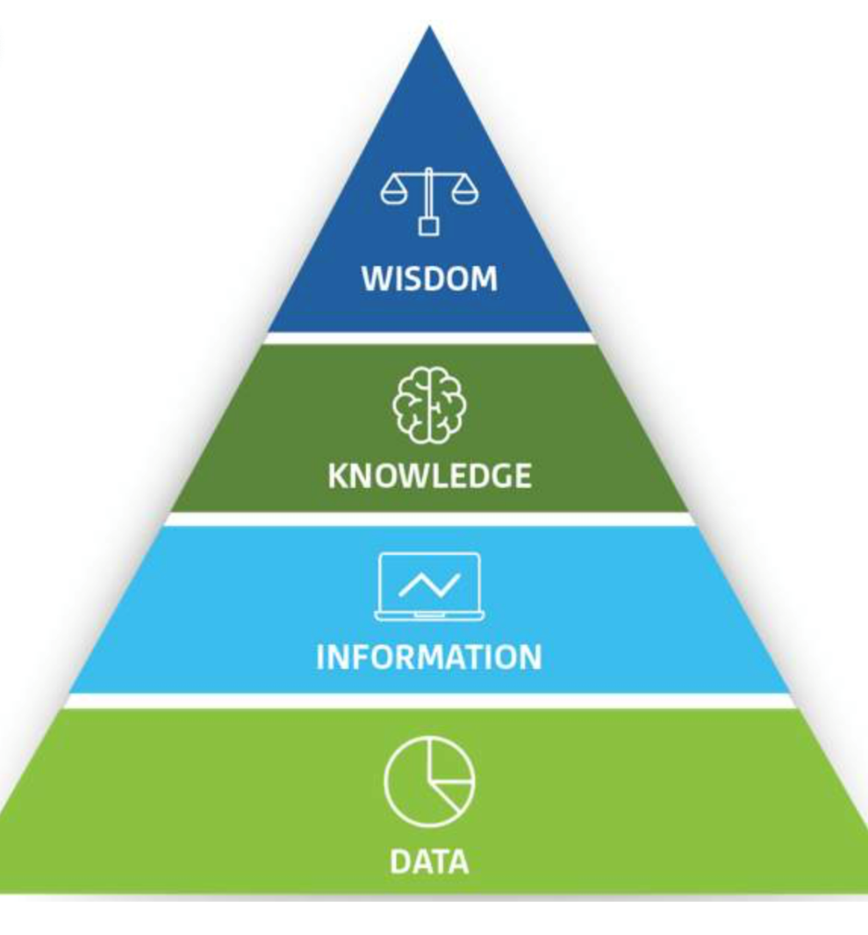
How can we help our stakeholders tell their story?
Source: SHSMD Credential: Analytics for Healthcare Strategists, March 2024

Slide 5
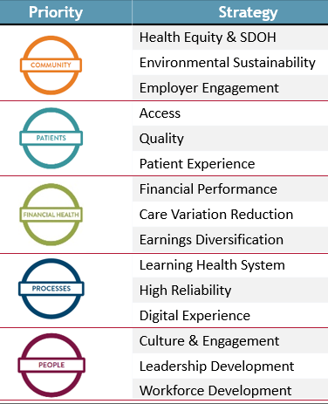
People Strategy Prioritizes Internal Communications
Strategic Plan Communication Planning
Align organizational strategy with communication plans
Track communications that support health system strategic plan and scorecard

Slide 6
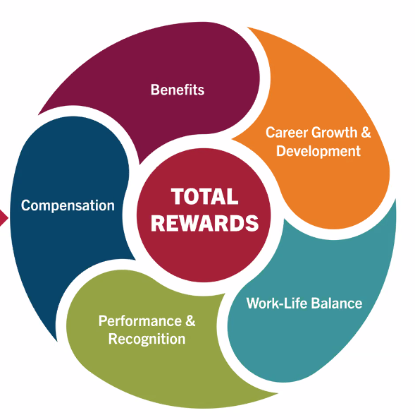
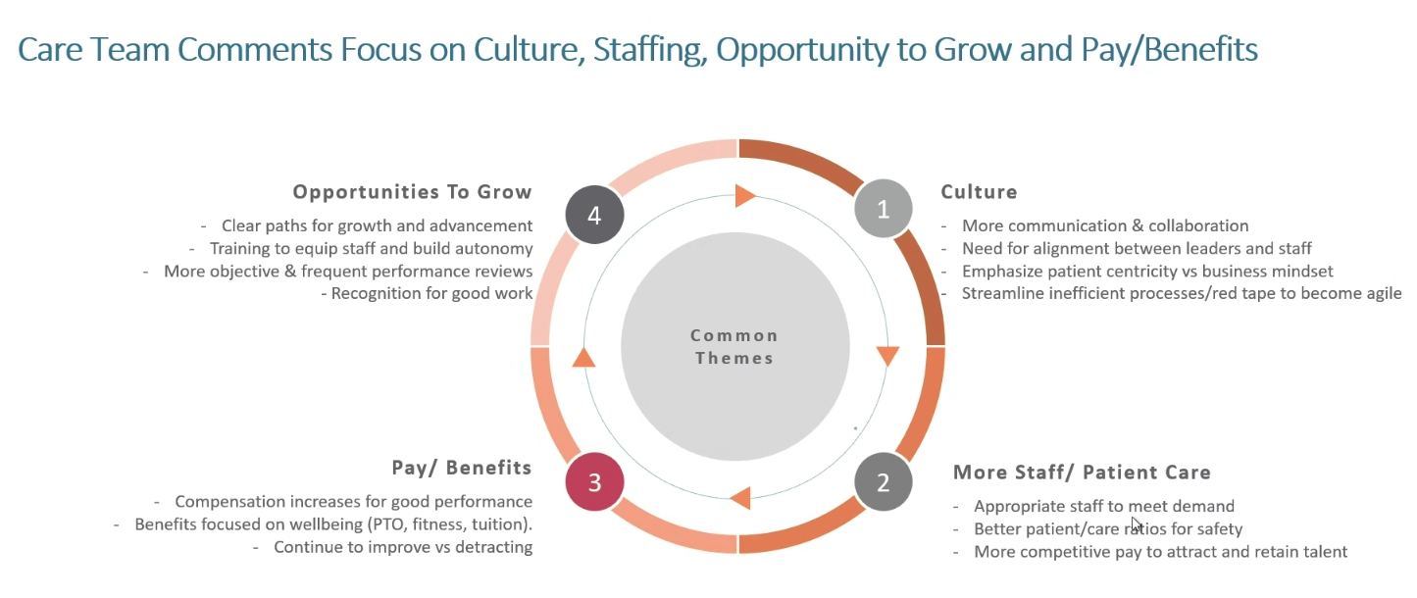
Leveraging Data to Position HR and Employee Benefit Messages
Data Source: Annual Care Team Survey

Slide 7
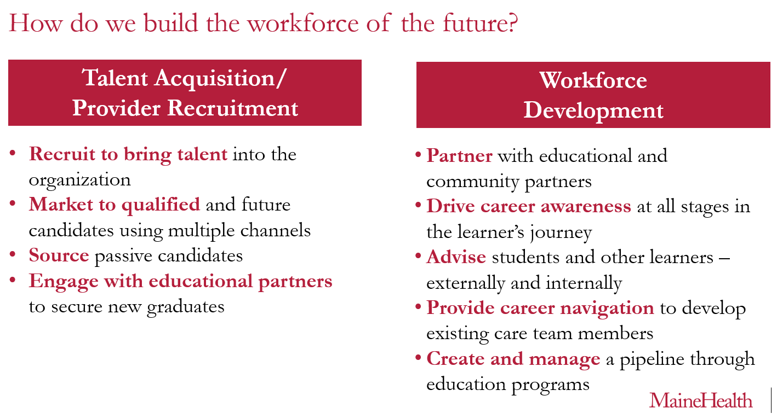
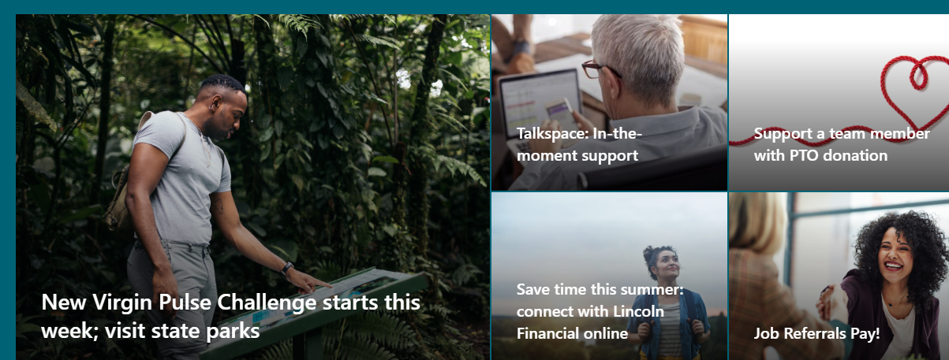
Connecting Opportunities
Presentations
Intranet & News
Consulting to position messages and
calls to action
Targeted Channels
Sharing stories how care team members use tools/programs and benefits
Care Team Voice:
Leader Communications
“With a little research on the MaineHealth intranet,
I had all the information I needed to get my teenager
set up with a Talkspace therapist.” - Care Team Member
Open
Enrollment
Tools
Recruitment Collateral

Slide 8
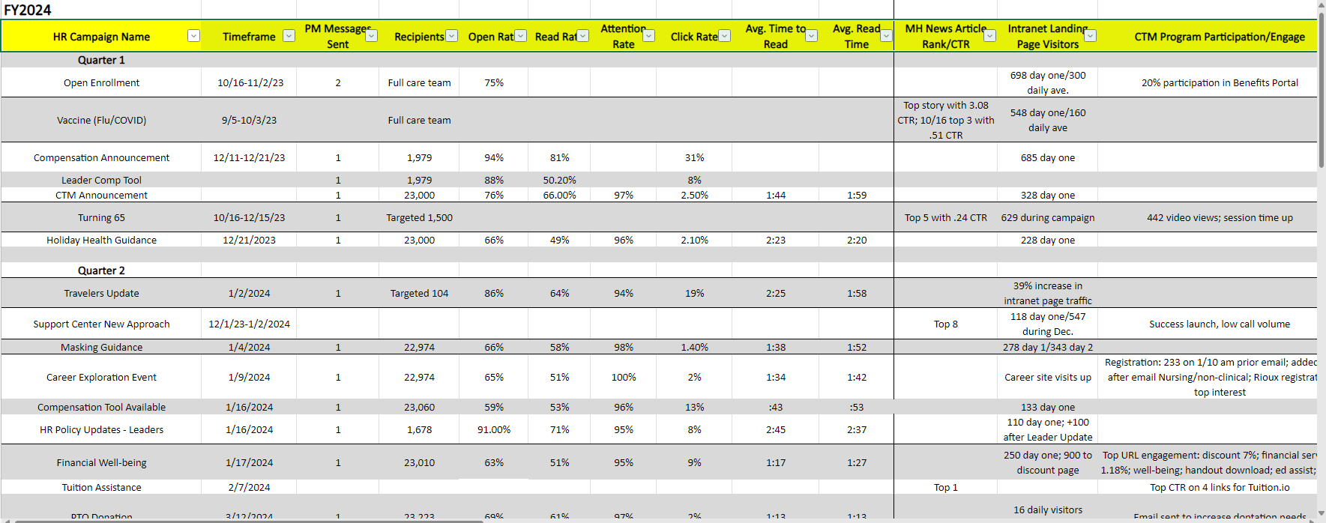
Metrics

Slide 9
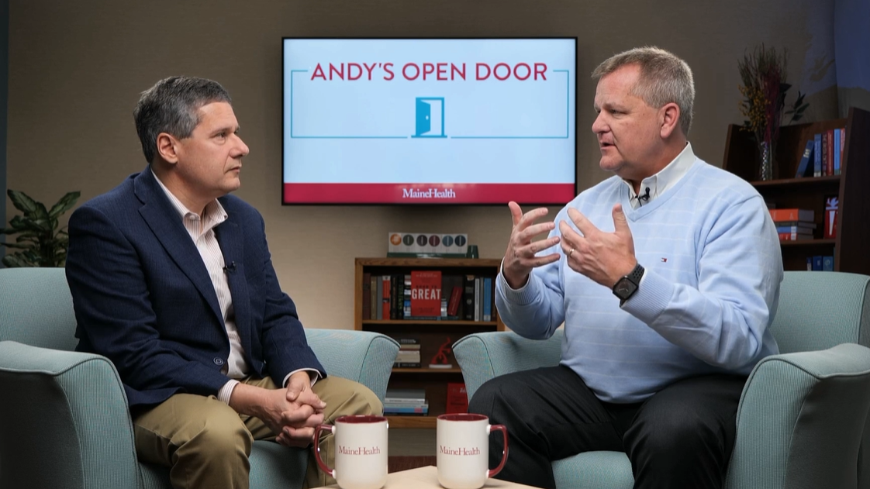
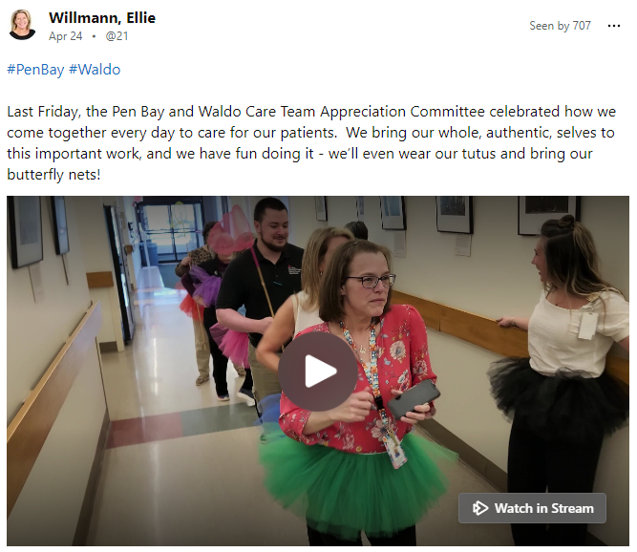
Case Study: Executive Communication– Transparency through stories
Streaming news program and podcast to break down complex topics and support recognition
Just Culture
Workplace Safety/Quality
Care Team Experience

Slide 10
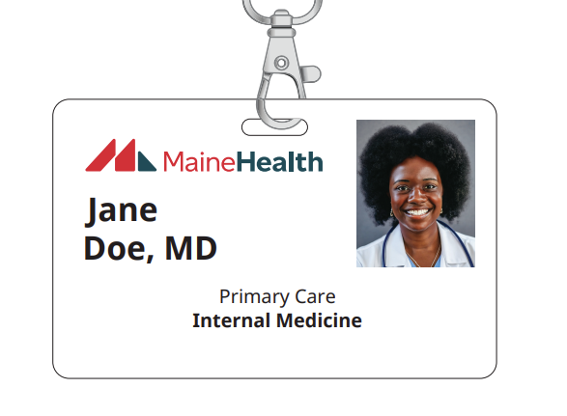
Case Study: Why a new brand? Telling the story with the ID Badge

Slide 11
DISCUSSION QUESTIONS
1) How do you use stories at your organization or health system?
Share an example
How do you use storytelling to define relevance or tie back to your strategic goals?
2) How do you use personalization to connect a story with the right audience, at the right time, at the right location?
3) What are the best practices for increasing read rates and other metrics?
What calls to action have you used?
4) How do you leverage your intranet to increase employee engagement?
5) What is next to modernize internal communications at your organization or health system?
6) How have you used AI to get started or add punch to your content?

Slide 12
Additional Takeaways
68% of people remember stories over facts
Be authentic
“Culture is the promise you make and keep to employees in their day-to-day experience”
Create opportunity to build an employee story and photo library
Research next steps to modernize communication with technology available to your health system or organization

Slide 13
Thank you!
Be on the lookout for any upcoming Member Meet Ups on the SHSMD webpage!

