Slide 1
Addressing the Child Mental Health Challenge: Building Your Response
SMSHD Annual Conference
September 27, 2026

Slide 2

WELCOME! Your Panelists
NATIONWIDE CHILDREN’S HOSPITAL/THE KIDS MENTAL HEALTH FOUNDATION
Katie Thomas, Director, Population Health Marketing at Nationwide Children’s Hospital & National Director, Content and Educational Partners for the Kids Mental Health Foundation
Donna Teach, Chief Marketing and Communications Officer – Nationwide Children’s Hospital & The Kids Mental Health Foundation
COREWELL HEALTH
Holly Sullivan, SVP, Brand, Marketing & Consumer Experience at Corewell Health

Slide 3
Let’s start a convo!
Grab a convo starter from the middle of the table.
Answer the question with your table!
Then talk about:
What are your pain points you are trying to solve?
What do you want out of the session?
We will report out!

Slide 4
Nationwide Children’s Behavioral Health System of Care
Inpatient/Observation
(Crisis Stabilization Unit, Acute Psychiatric Inpatient)
Care Coordination
Case Management
Telehealth
Residential
(Partnership with Psychiatric Residential Treatment Facility)
Research
Crisis
(Psychiatric Emergency Services, Mobile Response, TeleCrisis, ER Consult)
Intermediate Levels
(Partial Hospital, Intensive Outpatient, Intensive Home-Based Therapies)
Outpatient Mental Health
(Office-based therapy, psychiatry & psychological assessment; Interdisciplinary Outpatient Mental Health Clinics)
Consultation & Embedded Behavioral Health
(Primary Care, Pediatric Specialties, Schools, Juvenile Justice, Consultation-Liaison, Learning Collaboratives)
Prevention
(Universal, Selective, Indicated)
Notes:
Nationwide Children’s conceptualizes the community-wide system of care as a pyramid – the more intensive the level of care, the higher the level on the pyramid. Nearly all children can benefit from prevention programs, while only a relative few will need inpatient services. Each child, however, can receive the level of care they need.

Slide 5
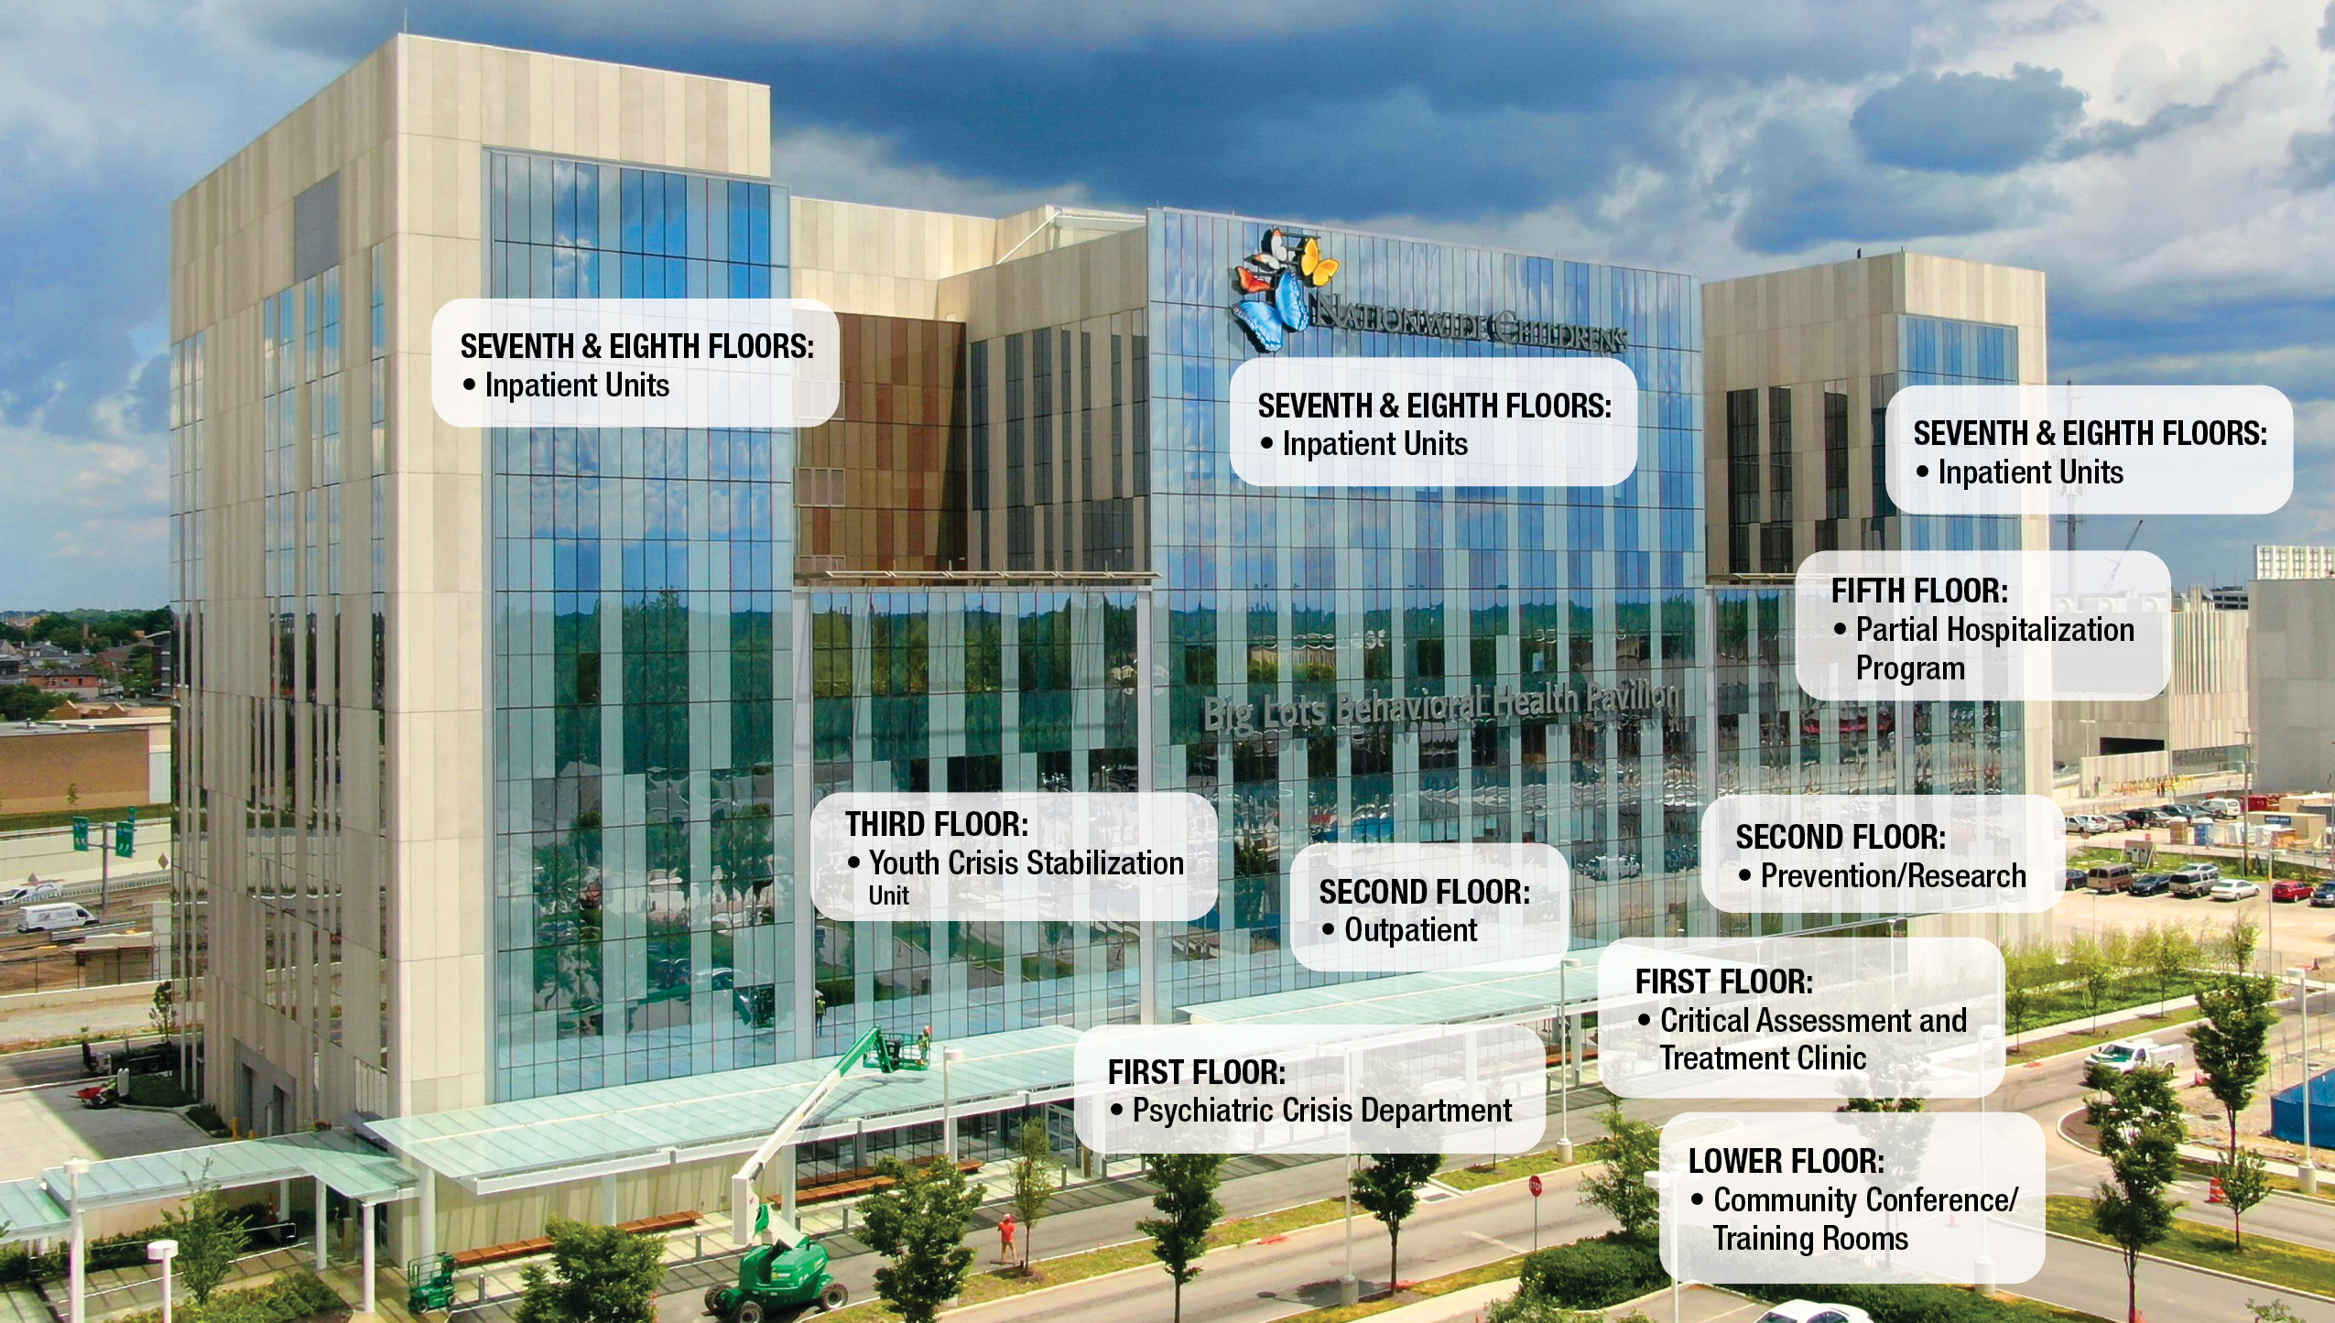
Dedicated March 3, 2020 – Watch a video tour.
Big Lots Behavioral Health Pavilion
5
Notes:
https://www.youtube.com/watch?v=c-vx7rREZFI

Slide 6

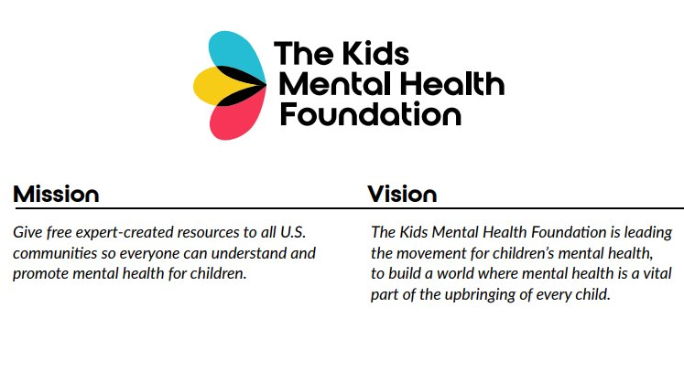

Our story – 2019 to Now
Evolving from a Campaign to Break Stigmas....
https://www.youtube.com/watch?v=7_mbywhmuWk

Slide 7
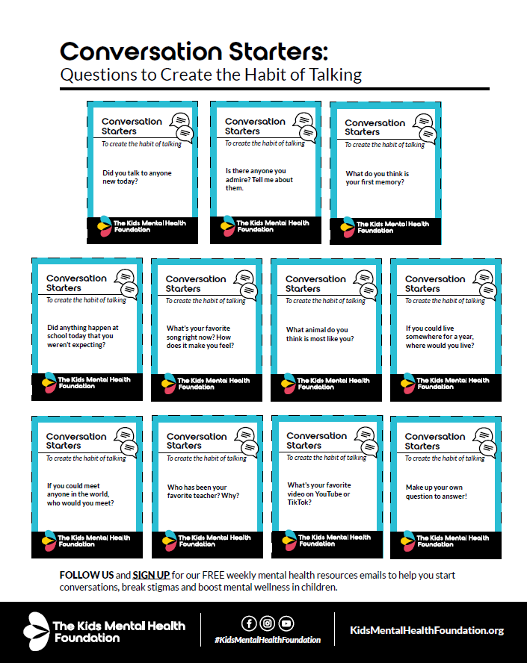
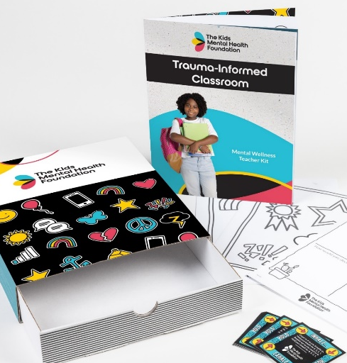
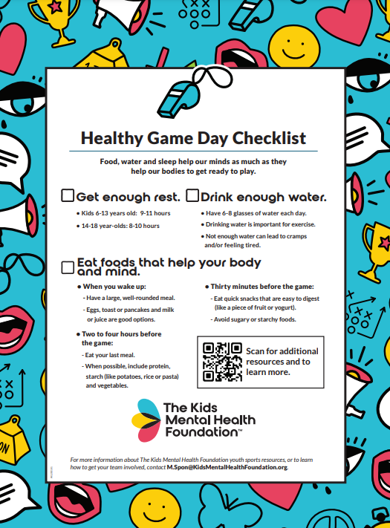
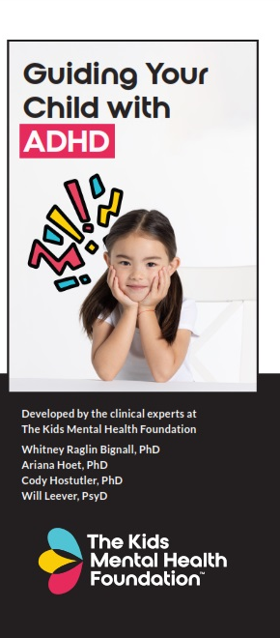
Wrapping the Child in Support
Parents, Caregivers & Mentors
Teachers & Schools
Youth-Serving Organizations & Coaches
Primary Care Providers - NEW
With the goal to:
Break Stigmas
Increase Literacy
Teach Skills
Breaking the stigma is crucial to building a supportive and empowering environment for kids and families.
Build an understanding of mental health and how to talk about it, know how to express feelings, recognize signs of concerns, and how to seek help when necessary.
Just like we know a child should eat their veggies and move their body to be physically healthy, we teach what they need for their mental health. KMHF tools show adults how to model the habits and skills we want children to emulate.
Notes:
So as KMHF our resources expanded…
Talk through each audience (mention whatsapp)…website, physical kits…
Our goal is to… read

Slide 8
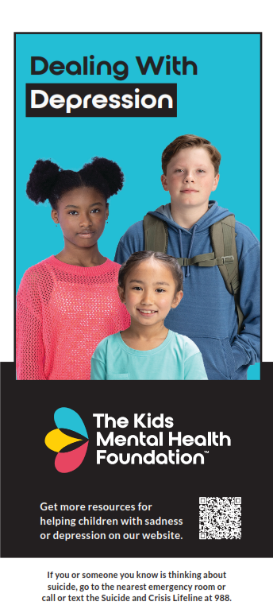
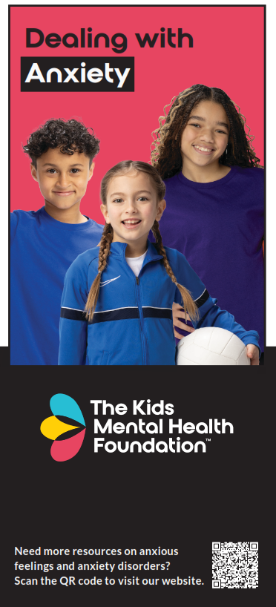
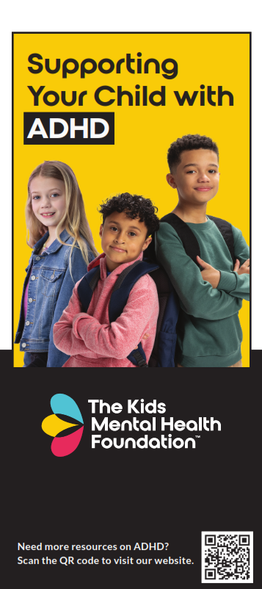
Primary Care Clinicians – Expanding Knowledge to Those on the Frontlines
Parents turn to primary care first when they have questions about their child’s behavioral health.
One out of four primary care clinicians (PCCs) feel they have sufficient training to manage behavioral health needs and thus many rely on referring to specialists.
Only 18% of families attend a behavioral health appointment after being referred by their PCCs.

Slide 9
IMPACT
33 million
lives impacted in
all 50 states, Guam and Puerto Rico
94%
of teachers noticed a change in student behavior since using Mental Wellness Kits
100%
of participating educators find the content relevant or very relevant to their audience.
93.8%
said they use KMHF resources in their classrooms
3 million
classrooms with educator curriculum and videos

Slide 10
The Corewell Health Story...

Slide 11
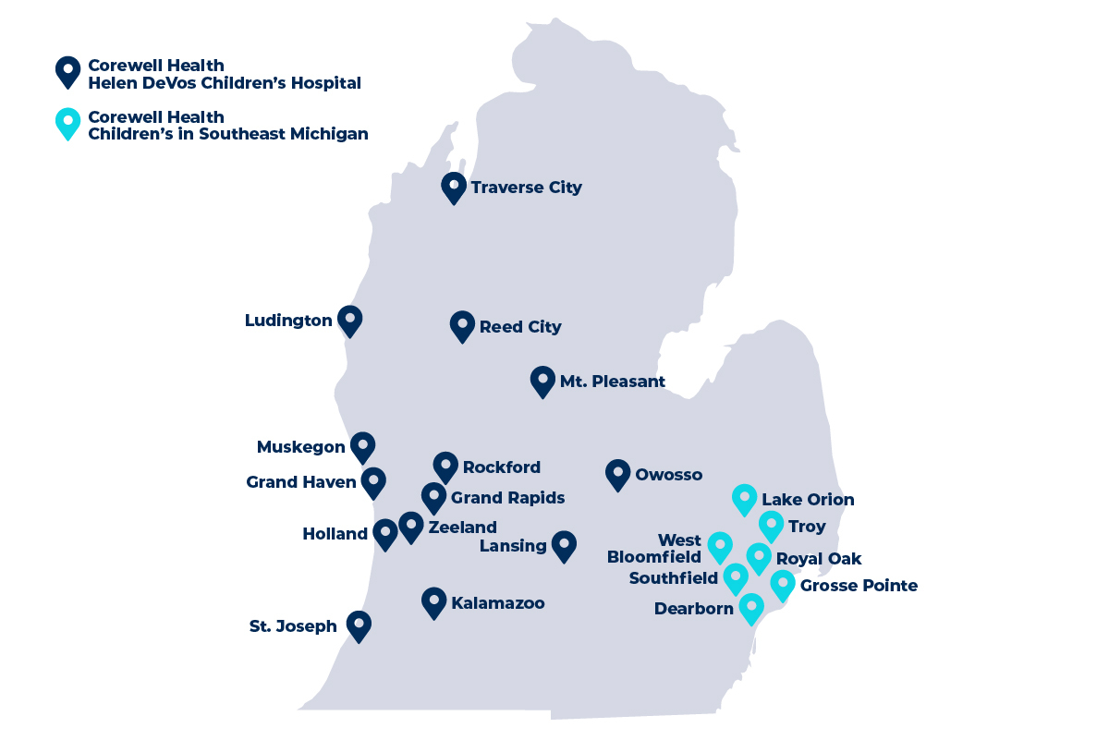

Why Corewell Health Focused on Kids Mental Health
4 Children's Hospitals +
17 Pediatric Offices
Mission Alignment
We saw an opportunity to make it easier to improve the health of our communities with easy access to mental health resources.
Organizational Readiness
We had recently established a statewide behavioral health program + started discussions of unifying our children's brand.

Slide 12
A Confidence Gap We Couldn’t Ignore
Parents
Teachers
Coaches
93% agree it's important to be proactive about kids' mental health
Only 40% feel equipped to support their kid's mental health
98% say mental health challenges are a barrier to a child's education
Only 20% feel equipped to support their student's mental health
92% of parents agree coaches need access to mental health resources
Less than 20% feel equipped to help student athletes with mental health
12

Slide 13

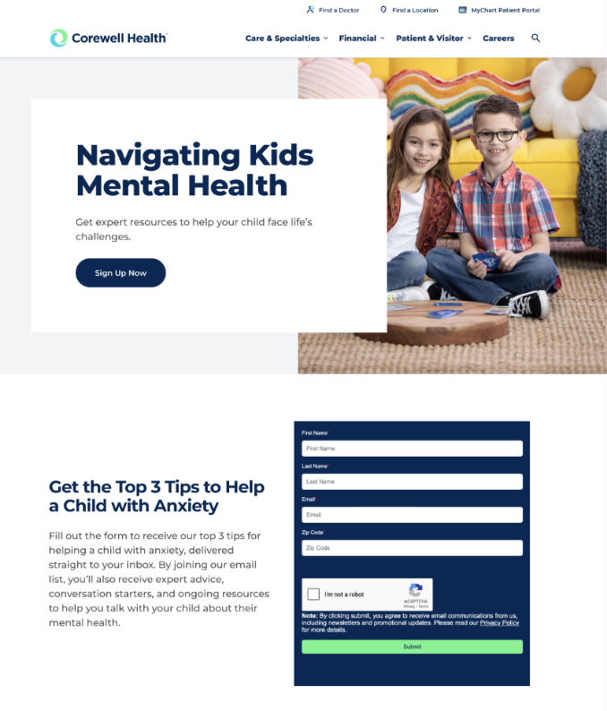
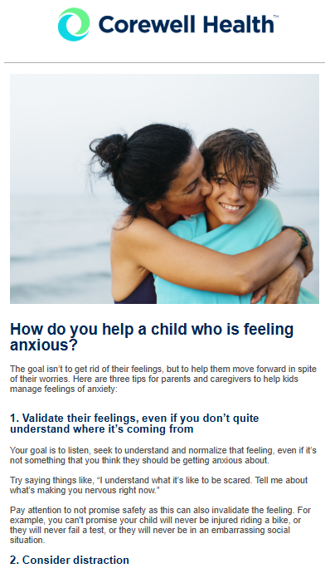
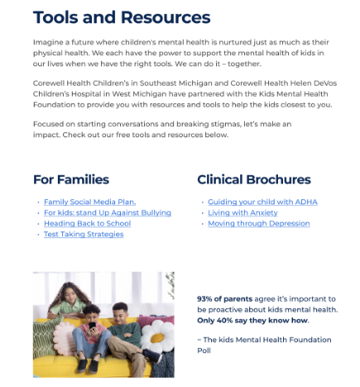
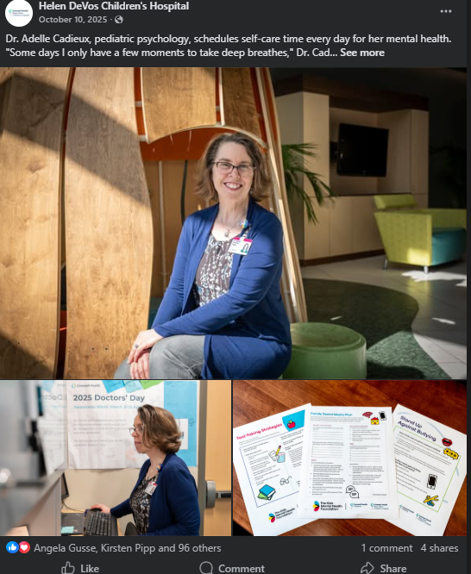
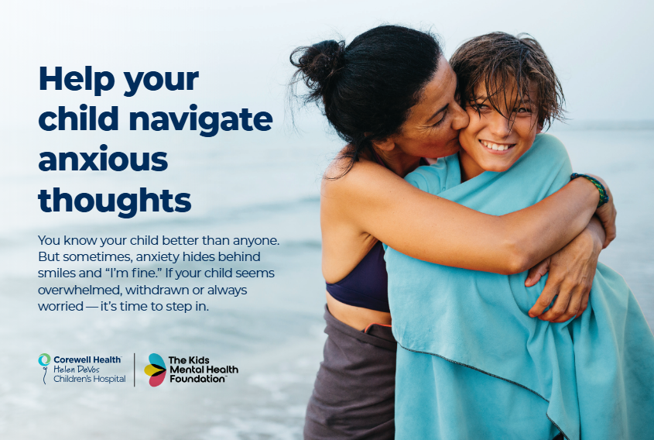
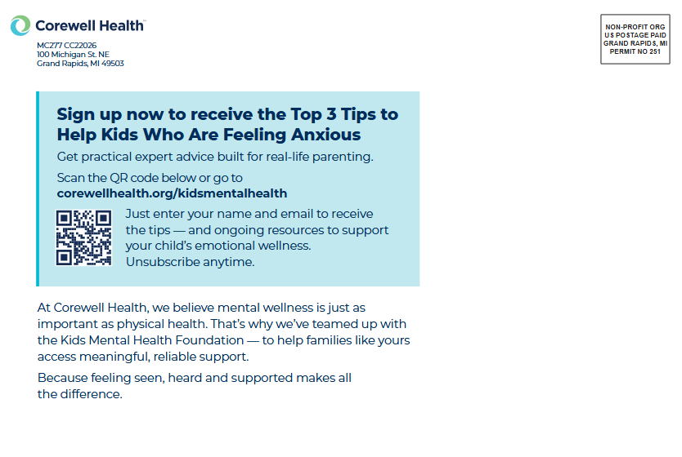
Key Strategies
Corewellhealth.org/KidsMentalHealth
Brochures distributed at our clinics
Mailer sent to 50,000 parents
Organic social media posts
Used psychologists as experts in PR pitches
Bi-Monthly Emails to Subscribers
Materials distributed to 400 Schools
Handouts at Suicide Prevention Walks
13

Slide 14
Results Since Launching in August 2025
Mailing sent to: 100,000 homes with kids 5-18 across all three regions
QR code on mailing scanned: 270 times
Email about program sent to: 80,000 patients
Opted in to emails:
825 people
Incredibly high open rate average: 41.1%
Website visits: 2,527
Top 5 File Downloads on Website:
121- Social Media Plan
109- ADHD Guide
97- Living with Anxiety
77- Stand up Against Bullying
74- Pressure Coping Plan
Social Media Post Engagement: 884 likes, shares or comments

Slide 15
Lessons Learned
1. Plan for ways of working + team capacity: We faced hurdles with our social media team’s adoption at the time of launch due to capacity and differing strategies.
2. Creating an internal core group with physician champions to guide the program has been an incredible success for the program.
3. Make it clear and easy for teams to order and print resources: Clinic adoption was slow because some teams weren’t sure how to order documents to hand out in their offices.

Slide 16
What's Next
1. Expand content to include consistent social media posts and physician relations visits to independent offices.
2. Secure corporate donor for program
3. Improve the audience experience on our website. Make it easier to find, order and share relevant resources.

Slide 17
MEASURING OUTCOMES IN BEHAVIORAL HEALTH
Alignment to Business Objectives
Audience Engagement (Consumer, Community Partner/School, Provider, Donor)
Impact: (From Community Needs Assessment to Program Outcome Measurement
TBIH (Hmmmm....)

Slide 18
The Science and Story Model
Bringing together the expertise of behavioral health and communications
Communicators
Plain language
Audience-centered design
Health literacy
Storytelling
Engagement and accessibility
Behavioral Health Experts
Clinical accuracy
Research and evidence
Best practices
Professional experience
Behavioral outcomes
Mental Health Literacy That Works
Notes:
It looks like this… Read slide
This partnership allows us to:
Reach broader audiences
Reduce stigma
Increase understanding
Improve confidence in help-seeking (if I understand a system, the language, what to do…)
Create measurable behavior change

Slide 19

Children’s Mental Health
APPENDIX
Children’s Mental Health
Our why…
Community Health Priority and Impact on Providers

Slide 20
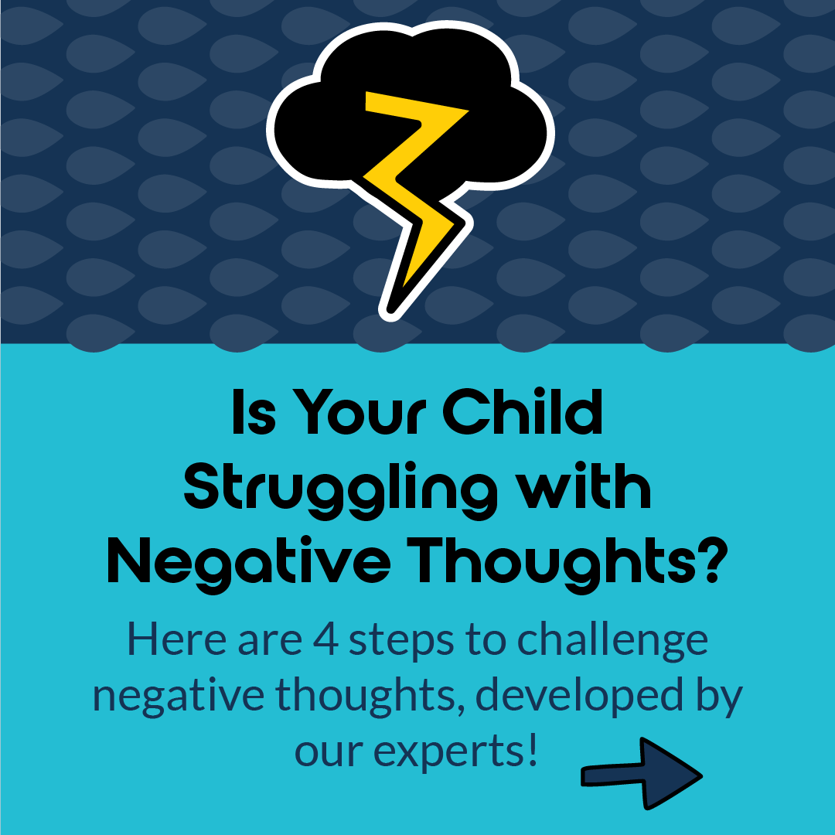





The numbers tell a story:
Our kids need help.
1 in 5 kids has a mental health disorder, and 50% of all lifetime mental illnesses start before the age of 14.
On average, it takes 10-11 years from a child’s first symptom of a mental health disorder until they receive treatment.
Less than 50% of kids who need treatment receive it.
As a result of decades of cultural stigma, poor funding, diminished pipelines into the industry, and low reimbursement rates, the pediatric behavioral health field is severely understaffed.
70% of American counties do not have a single child psychiatrist
150 million people live in federally designated mental health professional shortage areas​
Source: SAMHSA, CDC, NIMH

Slide 21
Where are parents getting
information?
4 in 5 parents of young children use social media to discuss parenting topics.
Nearly half of parents rate social media as very useful for getting new ideas to try.
C.S. Mott Children’s Hospital National Poll on Children’s Health, 2023
Source: SAMHSA, CDC, NIMH

Slide 22
Where are parents getting information?
Gentle
Parenting
Social Media Views/Posts
Parenting topics
Diagnosis topics
Respectful
Size of circle indicates total social media and google search size relative to each topic represented.
Positive
Authoritative
Autism
ADHD
Anxiety
Dyslexia
AH
Google Searches

Slide 23
The internet, social media, and mental health
“…TikTok videos with #mentalhealth in the caption have earned more than 43.9 billion views… and mentions of mental health on social media are increasing year by year.”
“The growing popularity of the subject means that creators of mental health content are filling a health-care gap. But social media apps are not designed to prioritize accurate, helpful information, critics say, just whatever content draws the biggest reaction.”
  Creators also changed from raising awareness to giving guidance
Washington Post, 2022
Online creators are de facto therapists for millions. It’s complicated.
Faced with explosive demand and few safeguards, creators of mental health content are defining their own ethics
Source: SAMHSA, CDC, NIMH

Slide 24
Online information and misinformation
For example, a study shared by CHADD found that of the 100 most popular TikTok videos on ADHD, 52% were misleading.
A systematic review investigating health misinformation in social media (e.g. Twitter, Facebook, Instagram, Flickr, Sina Weibo, VK, YouTube, Reddit, Myspace, Pinterest, WhatsApp), up to 87% of posts in some studies contained information that was misleading or untrue about health issues.
https://chadd.org/adhd-news/adhd-news-caregivers/social-media-videos-often-share-misinformation-about-adhd/
Suarez-Lledo, V., & Alvarez-Galvez, J. (2021). Prevalence of health misinformation on social media: systematic review. Journal of medical Internet research, 23(1), e17187.
Source: SAMHSA, CDC, NIMH

Slide 25
Mental health professionals have to fill this gap
“If there is lack of official information, people may be at risk for exposure to rumors that fill the information void” (Jones et al., 2017)
The U.S. Surgeon General advised health professionals to
  Use technology and media platforms to share accurate health information with the public
  Partner with community groups and other local organizations to prevent and address health misinformation
Jones N.M., Thompson R.R., Dunkel Schetter C., Silver R.C. Distress and rumor exposure on social media during a campus lockdown. Proc. Natl. Acad. Sci. U. S. A. 2017;114(44)
Source: SAMHSA, CDC, NIMH

Slide 26
Children’s Mental Health
Our why…
Children’s Mental Health
The Role of Marketing and Communications Professionals

Slide 27

As a healthcare marketing leader...
Why it matters to YOU!
Parents and caregivers are looking to their healthcare system for answers
Healthcare organizations have an opportunity to serve their communities and be a leader
Providing mental health information decreases the demand for treatment and improve wait times.

Slide 28

Communities across the country are seeking resources and information
Parents and caregivers are looking for information and solutions and look to their healthcare organization for answers.
Teachers and schools are seeking guides and tools to support their classrooms and school communities.
Community leaders are seeking a consistent and impactful expert to inform mental health initiatives.

Slide 29

Opportunity to Serve Communities and Position Organization as a Leader
Healthcare organizations have an opportunity to serve their communities and provide resources that:​
  Provide a solution and build trust​
  Create community connections​
  Identify them as a key resource and leader​ in mental health
  Give a voice to mental health in your community

Slide 30

Providing Resources Improves Demand and Wait Times
Providing mental health information and resources to your communities will help to:
Increase knowledge
Reduce stigmas
Build literacy and skills
With the goal overtime to decrease the demand for treatment and improve wait times.

Slide 31


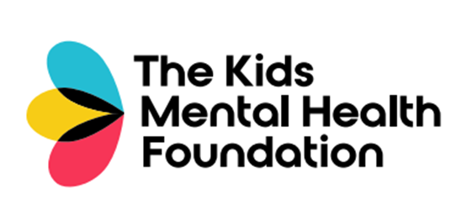
The Need: In 2023– Evolve from A Cause Platform Campaign to a National Cause Organization
National Call-to-Action Platform Campaign
A high-profile consumer call-to-action campaign that galvanizes efforts under a singular campaign name creating a sense of urgency to give and activate.
National Cause Organization
Centers its focus on impacting the larger cause being addressed. A self-sustaining organization with collective impact through awareness, collaboration and programmatic outcomes

Slide 32
Questions?
Please be sure to complete the session evaluation on the mobile app!

